Slide 1
Detecting FoG in Parkinson Patients using IMU sensor and AI
Presented by Ahmad Mostafa

Slide 2
Motivation behind the project

Slide 3
Problem Definition

Slide 4
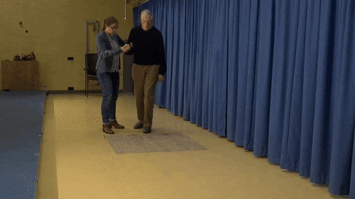
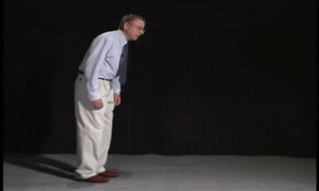
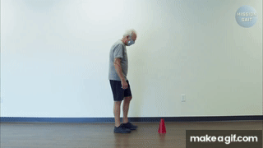
What is Freeze of Gait?
Freeze of Gait is an occurring hesitation or a complete halt of movement
It is often a symptom of Parkinson disease, which affects 10 million people world wide

Slide 5
Why is it important to detect Freeze of Gait?
Improved patient care
Fall prevention
Long term monitoring
Research and insights (the main goal of the Kaggle competition)

Slide 6
Dataset description
The data was collected by multiple research foundations, and was put on Kaggle as a public dataset
Sensor Settings
The channels of the sensor are accelerations in Anteroposterior, Medio lateral and Vertical movement

Slide 7
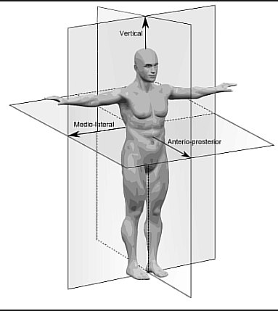
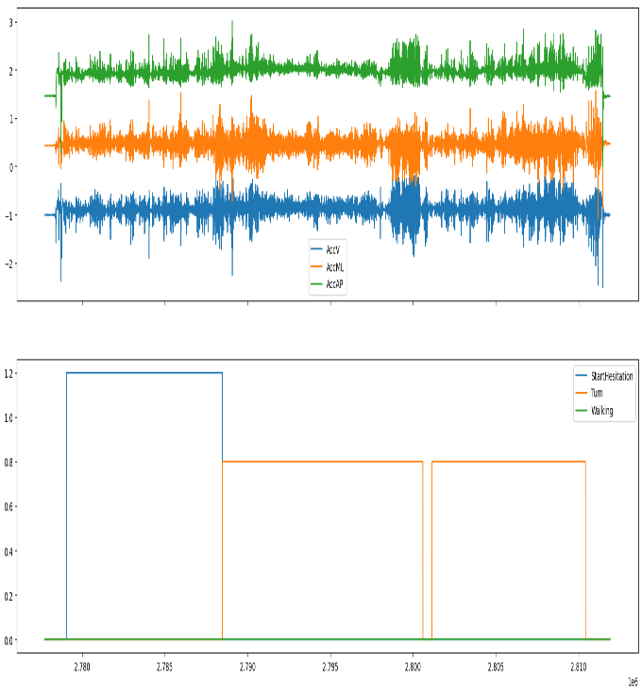
Data sample

Slide 8
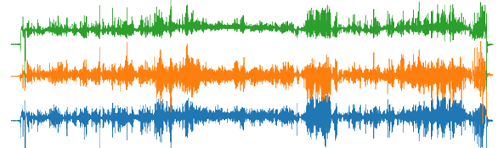
How sliding window works:
Window 1
Window 2
Window 3

Slide 9
Research questions
What is the best model for sequence to label case?
What is the best model for sequence to sequence case?
What is the best time window?
How small the time window can get?
What is the best combination of channels?
What is the best shallow model for low computation applications?

Slide 10
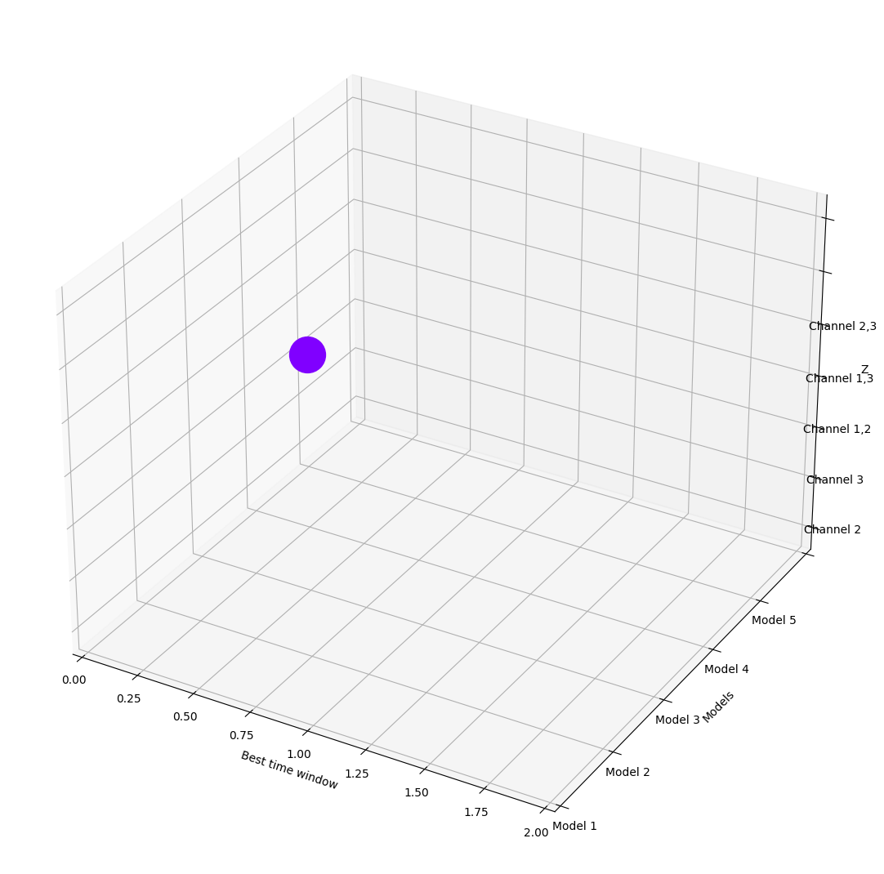
Methodology
Answering all of those questions at once to find the best model over all require a multidimensional large product, reaching a product of 264 different models

Slide 11
Another approach
Answering all questions at once finding that one super model is needs extensive training
In order to have a sense of the answer, another approach was made; A greedy dimension like approach
Assuming the data extracted features is similar between models, I decided to answer each question as a one dimension question, By
Making the other questions constant
Answering one question,
then continue with the others
Then trying every answer together

Slide 12
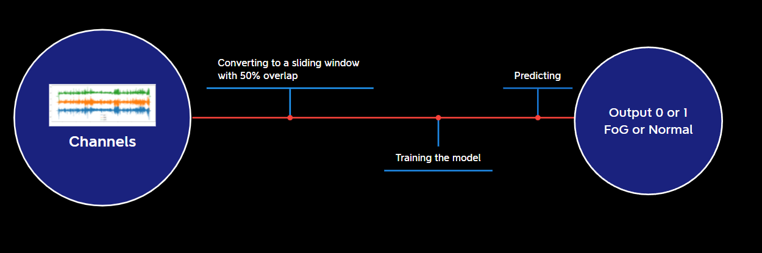
Model pipe

Slide 13
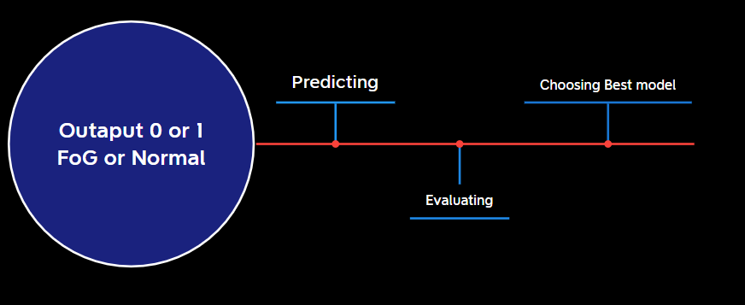
Output evaluation pipe

Slide 14
General parameters and setup
Keras was used as the main workframe
1650 GTX was used to train models
L1 and L2 were used
5 folds cross validation was used
10% of the training data was used as validation
Decaying learning rate was used in most models as well as Early stopping
Adam Optimizer was used

Slide 15
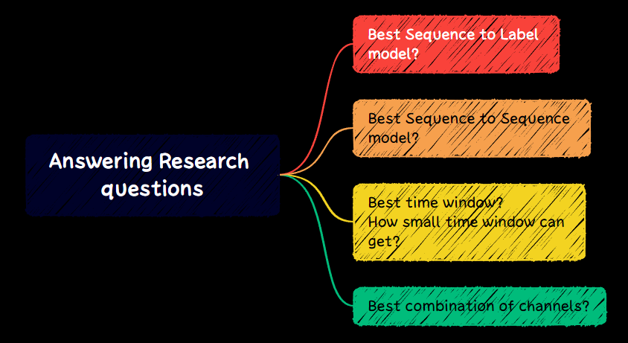

Slide 16
Why Having a sequence to sequence setup and a sequence to label setup?
Sequence to label provides higher accuracy but with a con of weighting for the whole sequence to be processed
Sequence to Sequence provides immediate response time, but with a con of lower accuracy

Slide 17
Best Sequence to Label model
In order to answer this question, 6 models with different number of kernels were tried
The time window was set to 2 seconds as a constant
Full channels were chosen

Slide 18
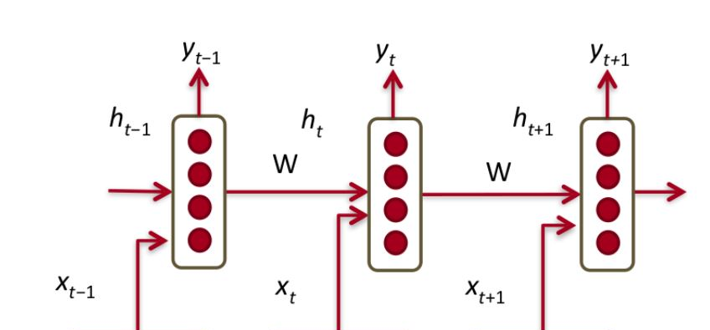
Illustration
Parallel LSTMs are referred to as units
Ex. This is a 4 unit one layer LSTM network

Slide 19
LSTM models
Model | Training accuracy | Validation accuracy | Test accuracy | epochs | Recall | Precision | F1
10 unit | 0.77846 | 0.7874 | 0.7795 | 53.8 | 0.77972 | 0.7793 | 0.77952
50 unit | 0.83783 | 0.84078 | 0.82158 | 94.4 | 0.8219 | 0.8215 | 0.8217
100 unit | 0.8891 | 0.8698 | 0.8284 | 222.4 | 0.8286 | 0.8282 | 0.8284
2 layer 10 unit | 0.8069 | 0.8093 | 0.8026 | 76 | 0.8028 | 0.8024 | 0.8026
2 layer 50 unit | 0.8315 | 0.8375 | 0.7955 | 247.8 | 0.7957 | 0.7953 | 0.7955
CNN-LSTM | 0.797 | 0.8073 | 0.7961 | 130.4 | 0.7963 | 0.7959 | 0.7961

Slide 21
Sequence to sequence
Sequence to sequence approach was and multiple models were tried to achieve best results
12 seconds was set to test the sequence to sequence capability

Slide 22
Sequence to sequence cont.
Model | Training accuracy | Validation accuracy | Test accuracy | epochs | Recall | Precision | F1
10 unit | 0.7193 | 0.7353 | 0.7219 | 30.8 | 0.7219 | 0.7219 | 0.7219
50 unit | 0.7735 | 0.7803 | 0.7559 | 44.6 | 0.7559 | 0.7559 | 0.7559
100 unit | 0.744 | 0.7549 | 0.7348 | 19.4 | 0.7348 | 0.7348 | 0.7348
100 unit s2 | 0.7457 | 0.7382 | 0.7317 | 120.6 | 0.7317 | 0.7317 | 0.7317
100 unit s3 | 0.8079 | 0.813 | 0.7981 | 301.0 | 0.7981 | 0.7981 | 0.7981
2 layer 50 unit | 0.7695 | 0.778 | 0.7683 | 131.0 | 0.7683 | 0.7683 | 0.7683

Slide 24
Different Time intervals
Different time intervals were used as well as full sequence to sequence to determine the best approach and the smallest time interval that I could get
10 Unit LSTM was set as a constant with full channels

Slide 25
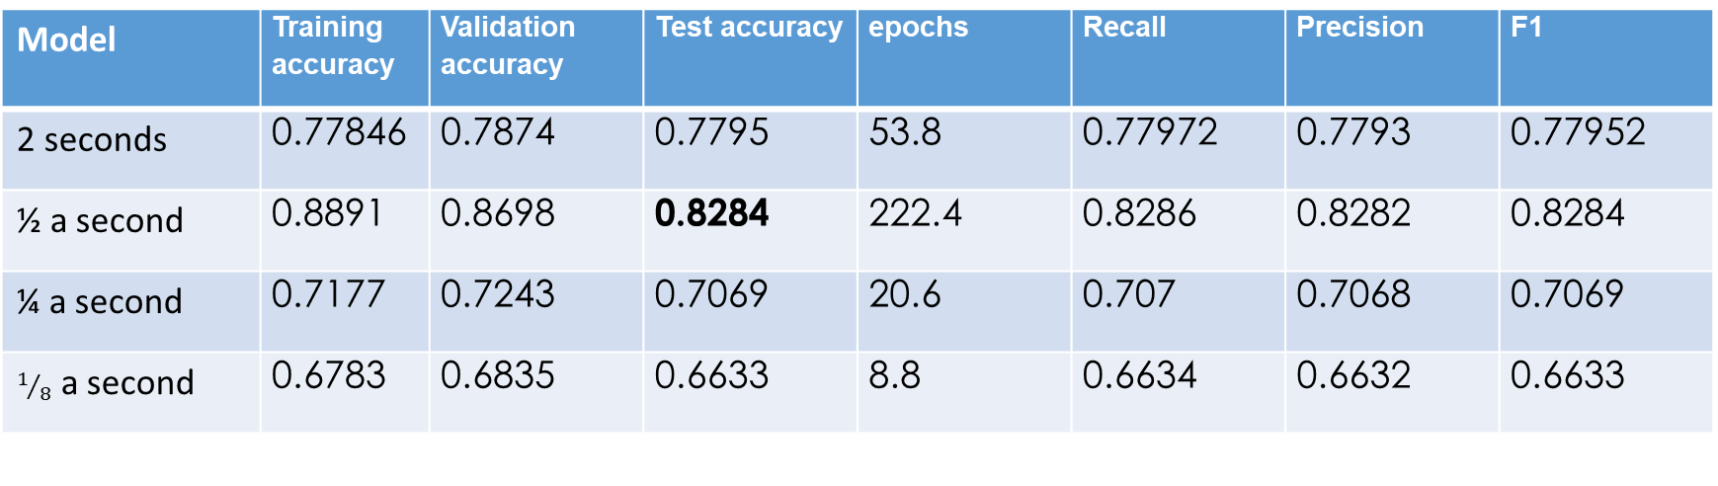
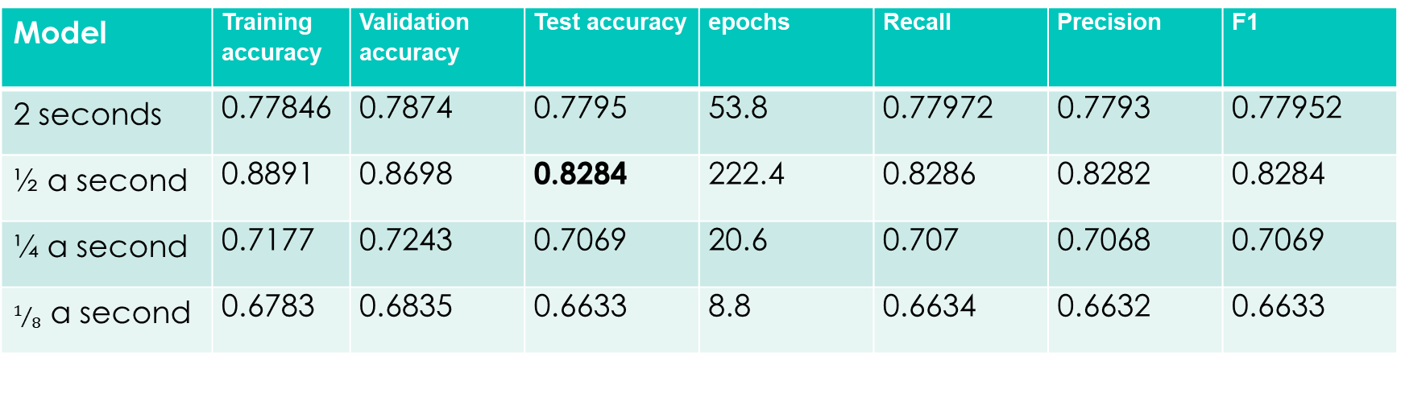
Different Time intervals cont.
Model | Training accuracy | Validation accuracy | Test accuracy | epochs | Recall | Precision | F1
2 seconds | 0.77846 | 0.7874 | 0.7795 | 53.8 | 0.77972 | 0.7793 | 0.77952
½ a second | 0.8891 | 0.8698 | 0.8284 | 222.4 | 0.8286 | 0.8282 | 0.8284
¼ a second | 0.7177 | 0.7243 | 0.7069 | 20.6 | 0.707 | 0.7068 | 0.7069
$1/8$ a second | 0.6783 | 0.6835 | 0.6633 | 8.8 | 0.6634 | 0.6632 | 0.6633
Model | Training accuracy | Validation accuracy | Test accuracy | epochs | Recall | Precision | F1
2 seconds | 0.77846 | 0.7874 | 0.7795 | 53.8 | 0.77972 | 0.7793 | 0.77952
½ a second | 0.8891 | 0.8698 | 0.8284 | 222.4 | 0.8286 | 0.8282 | 0.8284
¼ a second | 0.7177 | 0.7243 | 0.7069 | 20.6 | 0.707 | 0.7068 | 0.7069
$1/8$ a second | 0.6783 | 0.6835 | 0.6633 | 8.8 | 0.6634 | 0.6632 | 0.6633

Slide 27
Different channels
Different channel combination were tried in order to find out what channel mixture works best
100 unit LSTM and 2 seconds window were set

Slide 28
Different channels cont.
Model | Training accuracy | Validation accuracy | Test accuracy | epochs | Recall | Precision | F1
AccAP | 0.8027 | 0.8083 | 0.7985 | 155.6 | 0.7987 | 0.7983 | 0.7985
AccML | 0.6911 | 0.6988 | 0.6872 | 42.4 | 0.6873 | 0.687 | 0.6872
AccV | 0.7148 | 0.7342 | 0.7285 | 80.6 | 0.7287 | 0.7283 | 0.7285
AccML & AccAP | 0.8169 | 0.8107 | 0.7671 | 143.6 | 0.7673 | 0.7669 | 0.7671
AccV & AccAP | 0.8413 | 0.8389 | 0.8159 | 161.0 | 0.8162 | 0.8158 | 0.816
AccV & AccML | 0.9108 | 0.8863 | 0.8409 | 223.8 | 0.8411 | 0.8407 | 0.8409

Slide 30
Shallow models
In case of low computational power or low cost devices, Shallow models are suggested
2 seconds engineered features and 4 seconds engineered features
 | Training accuracy | Test accuracy
SVC radial bases function kernel | 0.7374 | 0.7343
SVC Polynomial kernel | 0.6994 | 0.6948
SVC linear kernel | 0.6547 | 0.6438
Random Forest 3 md | 0.6979 | 0.6908
Random Forest 10 md | 0.7828 | 0.7511
Random Forest 50 md | 1 | 0.7488
 | Training accuracy | Test accuracy
SVC radial bases function kernel | 0.7203 | 0.7328
SVC polynomial kernel | 0.6757 | 0.6850
SVC linear kernel | 0.6187 | 0.6364
Random Forest 3 md | 0.6718 | 0.6734
Random Forest 4 md | 0.6806 | 0.6777
Random Forest 10 md | 0.7922 | 0.7430
Random Forest 50 md | 0.9999 | 0.7383

Slide 32
Conclusion and further work
Best sequence to label models were 100 units
Best sequence to sequence model reached was model 3 with settings 3
Best time interval was ½ a second
Best channel combination was AccML and AccV

Slide 33
Acknowledgment

Slide 34
Thank you

Slide 35
Dense model for 4 seconds
Profiler should be used before applying the model on small processors
0.6559 accuracy was reached and is not recommended

Slide 36
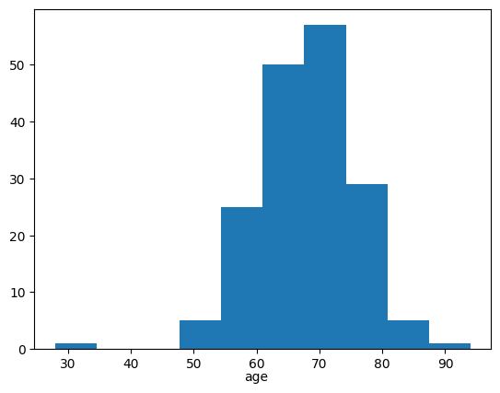
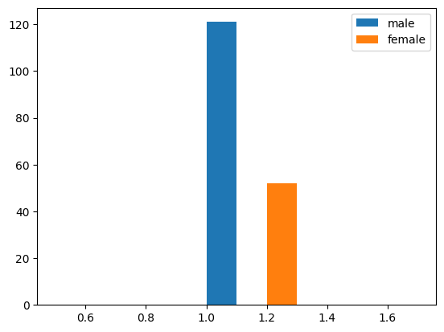
Dataset description cont.

Slide 37
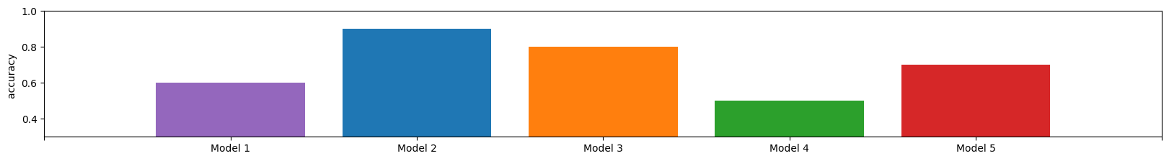
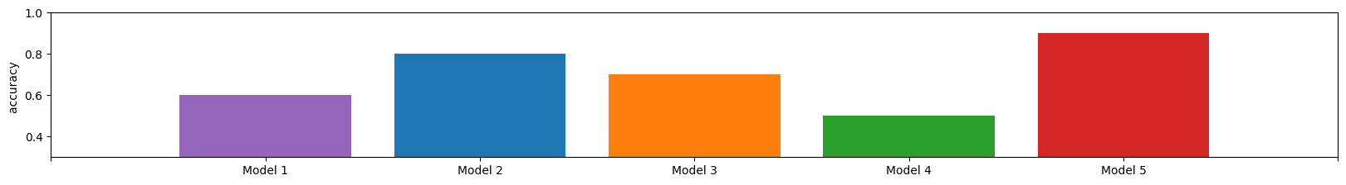
Example.
Regarding question 1 model 2 was the best
Regarding question 2 model 5 was the best, and so on

Slide 38
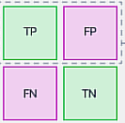
Recall vs precision

Slide 39
Notes
Recall, Precision and F1 score were so close in the last slide
Numbers were checked if there was a wrong with the code
The numbers have difference in there 8th decimal point or so
Upon searching, This could be caused by:
Balanced data
Task characteristics
 | recalls | precisions | f1
Average | 0.755903339 | 0.755903482 | 0.755903435

Slide 40
100 unit LSTM different settings
Setting 1:
Exponential decay learning rate initially 1e-3 decaying by 90% with 128 batch size
Setting 2:
Learning rate set to 1e-5 with no decay and normal Xavier weight initializer with 128 batch size
Setting 3:
Exponential decay learning rate initially 1e-4 decaying by 90% and 256 batch size with normal Xavier initializer and 1 clip value

